Slide 1


Andrei Frank, Policy and Advocacy Coordinator
“Mentoring Advocacy Day”
15 November 2023

Slide 2
meet the

Slide 3

the voice of education in Europe
connect
we promote a holistic vision to lifelong learning, from cradle to grave, by facilitating European cross-sector cooperation among civil society organisations in education and training and voicing citizens’ concerns

Slide 4
our network is 44 EU NGOs strong
connect
founded in 2005
50.000+ education and training institutions
2.5 millions individuals

Slide 5
our objectives for lifelong learning
connect
build inclusive and democratic education systems
widen access to quality education for all citizens
increase the relevance of education to modern societies

Slide 6
our members represent all education stakeholders and sectors
connect
learners
educators
practitioners
parents
volunteers…
formal
non-formal
informal

Slide 7

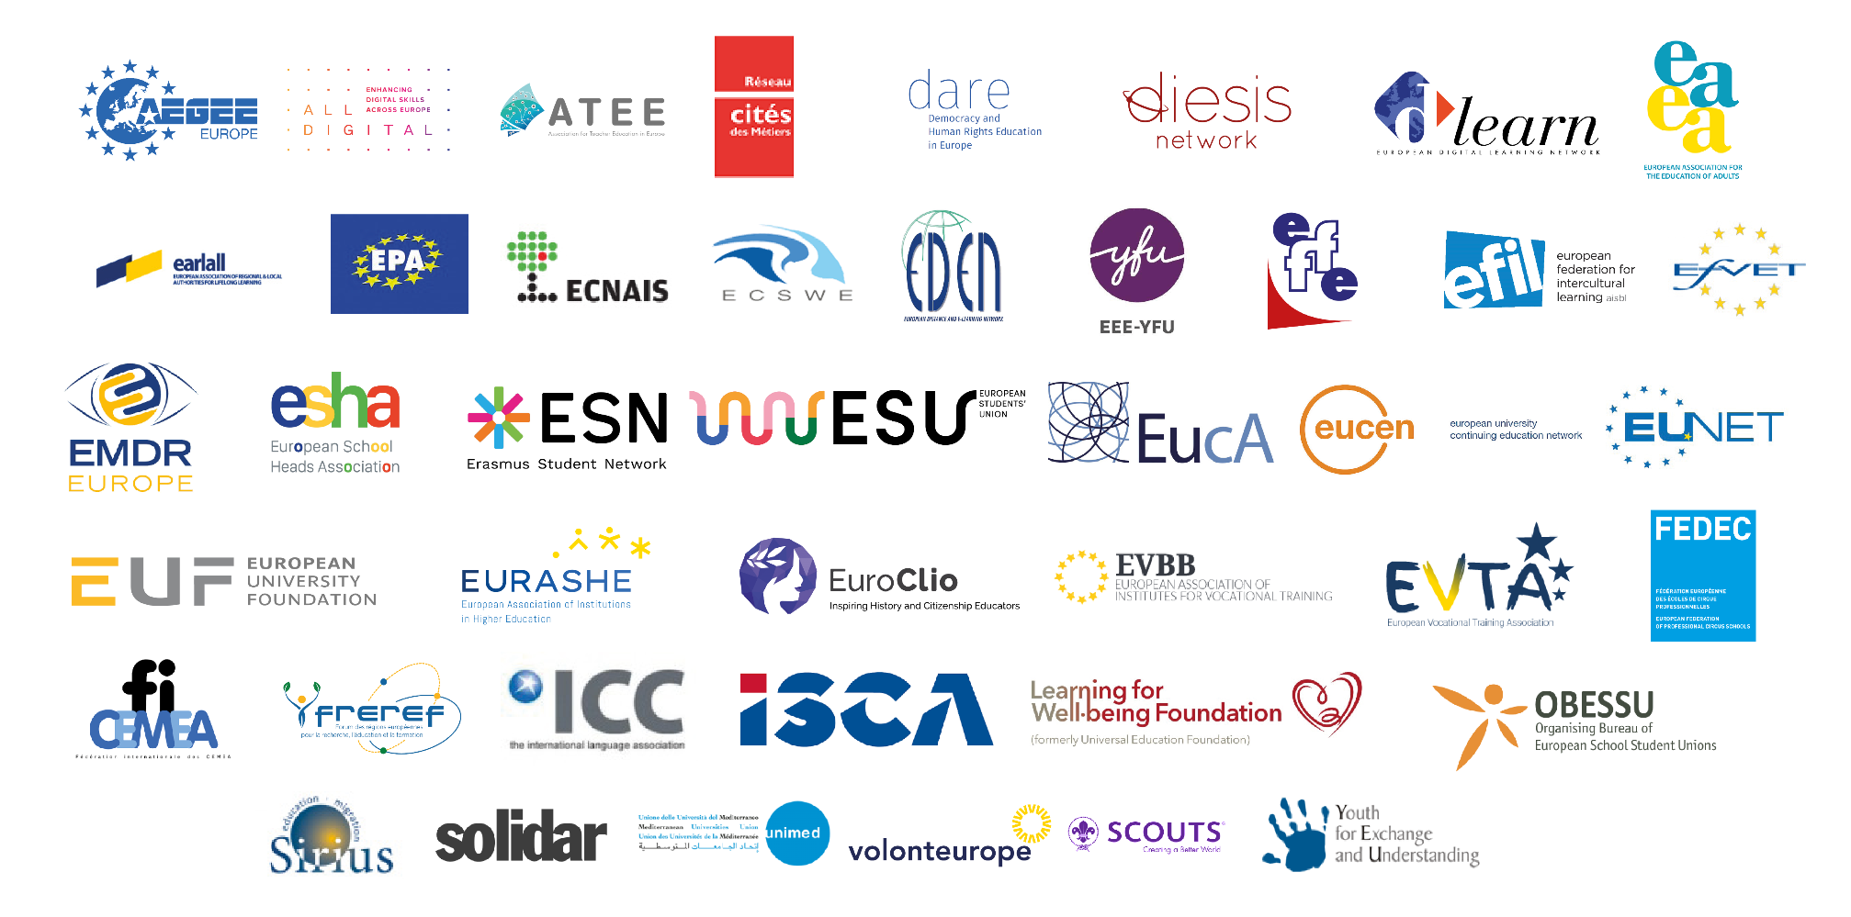
connect

Slide 8
our priorities this year
learn
lifelong learning approach - a holistic vision
life skills and skills for life
recognition and validation of non-formal education

Slide 9
2017
engage
Reimagining Education for the Digital Age
Notes:
Available here

Slide 10
engage
2022
Investment in education & training:
a public good for all
Notes:
Available here

Slide 11
2023
engage
Key competences for all: a lifelong learning approach to skills

Slide 12
EU priorities: where next?
engage
DG EAC
DG EMPL
European Commission Work Programme 2024
European Parliament - EMPL Committee
Other institutional partners

Slide 13
DG EAC advocacy
engage
European Education Area – mid-term review and deadline (2025)
National level mid-term review

Slide 14
DG EMPL advocacy
engage
European Year of Skills
Skills Agenda
Europass
ALMA (Aim, Learn, Master, Achieve) Programme

Slide 15
European Parliament advocacy
engage
EMPL Committee
EU Elections
Report on Quality Traineeships
Practices of mentoring

Slide 16
European Commission WP 2024
engage
End of mandate
Proposal for a Council Recommendation on attractive and sustainable careers in higher education
EU elections
Local constituencies
European Political Parties’ Manifestos
Notes:
Annex to the WP, containing all initiatives, here.

Slide 17
Other institutional partners
engage
Council of Europe
Mentoring for Change
Training of mentors on women’s access to justice
European Economic and Social Committee
The Professional Charter for Coaching, Mentoring and Supervision of Coaches, Mentors and Supervisors
Committee of the Regions
Opinion on Mentoring

Slide 18
Mentoring: funding
engage
Erasmus+
CoR Opinion
Open Public Consultation - 8 December deadline
Next funding period
ESF+
CoR Opinion
Social partners
National funding and National Recovery and Resilience Plans

Slide 19
Mentoring: validation and recognition
engage
Cedefop Guidelines for Validation of NFIL
IMAGES project – alignment with ESCO
TRANVAL-EU – follow-up project
Council Recommendation on the Validation of Non-formal and Informal Learning

Slide 20
Mentoring: regional policy
engage
CoR Opinion
DG REFORM - Technical Support Instrument
National and regional capacity building

Slide 21
www.lllplatform.eu
info@lllplatform.eu

